Slide 1
Middle School
English
2
Lesson
1
My Happy
Everyday Life

Slide 2
Teen Talk: My Favorite Time of the Day
Somin: Hello! I’m Somin. I’m 15 years old, and I live in Korea. Please tell me about your favorite time of the day. You can also show me some pictures.
in+넓은 장소
~에 관하여
~(가운데)의, ~중의
show(4형식 동사)+간접목적어+직접목적어
= show some pictures to me

Slide 3
Diego: Hi, my name is Diego, and I live in Seville, Spain. My favorite time of the day is lunch time. My school usually ends around 2 p.m. On most days, my family gets together and has a big, long lunch.
’도시, 나라’의 어순
빈도부사(주로 일반동사 앞에 쓰임)
~ 경, 쯤
on+요일, 날짜
get together: 모이다
먹다 (=eats)

Slide 4
We usually have soup, vegetables, and meat. We also have a dessert like churros. After lunch, we usually take a siesta, a short nap. Both my father and I like to sleep under the tree in our garden.
= eat
~와 같은
~후에 (전치사)
┗─ 동격 ─┛
both A and B: A와 B 둘 다
명사(목적어) 역할을 하는 to부정사

Slide 5
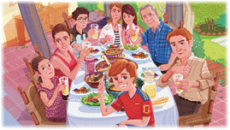
Q1. What does Diego’s family usually
eat for lunch?

Slide 6
Q2. What does Diego’s family usually
do after lunch?

Slide 7
Tabin: Hi! My name is Tabin, and I live near the Gobi Desert in Mongolia. I’m happy when I ride my horse. Horses are important in our culture. Almost everyone can ride a horse in Mongolia. In fact, we say, “We ride horses before we can walk.”
~ 할 때(접속사)
거의
~할 수 있다(능력을 나타내는 조동사)
사실
~하기 전에(접속사)

Slide 8
I take good care of my horse. I often brush him and give him some carrots. I enjoy riding especially in the evening before the sunset. Then the sky is red, and everything is peaceful.
take care of: ~을 돌보다
Tabin’s horse
give(4형식 동사)+간접목적어+직접목적어
enjoy –ing: ~하는 것을 즐기다
~하기 전에(전치사)
↔ sunrise

Slide 9
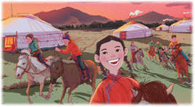
Q3. When is Tabin happy?

Slide 10
Q4. How does Tabin take care of her
horse?

Slide 11
Musa: Hi! I’m Musa, and I live in Nairobi, Kenya. My favorite time of the day is our running practice time. My friend, Tamu, and I are on the school’s running team. I’m happiest when I run with Tamu.
┗— 동격
———┙
┗— ~팀에 속해 있다
———┙
happy의 최상급

Slide 12
Our practice time isn’t boring because we can see many animals.
Many runners from Kenya won races in the Olympics. I’m so proud of them. Both Tamu and I want to be like them.
~ 때문에(이유의 접속사)
= a lot of
many+복수 명사
~ 출신의
win의 과거형
=Many runners ~ in the Olympics
└both A and B: A와 B 둘 다┛
~처럼
올림픽에서 우승한 케냐 달리기 선수들

Slide 13
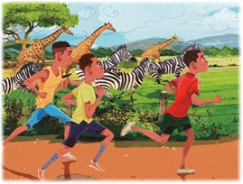
Q5. When is Musa happiest?

Slide 14
Q6. Why is practice time not boring
for Musa and Tamu?

Slide 15
Word Bank
usually | ad. 보통
vegetable | n. 채소
dessert | n. 디저트, 후식
nap | n. 낮잠
near | ad. 가까이
desert | n. 사막
Mongolia | n. 몽골
important | a. 중요한

Slide 16
Word Bank
culture | n. 문화
brush | v. (~을) 솔질하다
carrot | n. 당근
especially | ad. 특히
sunset | n. 일몰, 해 질 녘
peaceful | a. 평화로운
practice | n. 연습
race | n. 경주

